Slide 1

18th SG Meeting
South Gas Regional Initiative
Madrid, 30th January 2013

Slide 2
Agenda

Slide 3
II. Capacity Allocation Mechanisms
II.1. Draft Roadmap for Capacity Allocation Mechanisms (CAM Roadmap)
II.2. NW Capacity Allocation Platform
II.3. Improvements in the SP-PT CAM
II.4. 2012 OSP between SP-FR
II.5. Next steps and calendar
Area of work | Responsible | Starting | Deadline
OSP France-Spain: annual allocation of short-term capacities | TSOs | Nov. (yearly) | Dec. (yearly)
CAM harmonisation proposal (CAM pilot testing Sp‐Pt borders) | NRAs-TSOs | Jan. 2011 | Jun. 2012
CAM harmonisation proposal in the whole region | NRAs-TSOs | Jan.2012 | Dec.2013
Set up a common TSO Allocation Platform | TSOs | Jan.2014 | Dec.2014

Slide 4
II. Capacity Allocation Mechanisms
II.1. Draft Roadmap for Capacity Allocation Mechanisms (CAM Roadmap)
  ACER/ENTSOG CAM Roadmap for Europe (for information by ACER)
  CAM Roadmap for SGRI (for information by NRAs)

Slide 5
II. Capacity Allocation Mechanisms
II.1. CAM Roadmap for South Gas Regional Initiative
  GOAL: early implementation of the provisions from the CAM NC
  In line with the Roadmap for the early implementation of the CAM NC, developing by ACER and ENTSOG.
1
2
3

Slide 6
II. Capacity Allocation Mechanisms
II.1. CAM Roadmap for SGRI
  Capacity product definition and calendar (I)
  Main issues to be decided:
    Bundled/Virtual products to be offered
    Standard capacity products to be prioritised
    Capacity reserved for each product
    Allocation calendar for 2014 and onwards
    IP where the products will be allocated (physical or virtual points)
    Coordination CMP-CAM
1

Slide 7
II. Capacity Allocation Mechanisms
II.1. CAM Roadmap for SGRI
  Capacity product definition and calendar (II)
  Definition of available bundled capacity for the next 15 years (Oct 2014...), agreement on the split of capacity (Q, yearly, 15 years): 80/20
  VIP or two IP ?
  Common criteria on: unbundled / interruptible / backhaul
  Monthly capacity products have been allocated by OSP until 31st March 2014
  Monthly capacity products to be offered before March 2014 for the period April 2014-September 2014. Proposal: Maintain prorate?
1
  SPAIN-FRANCE (I)

Slide 8
II. Capacity Allocation Mechanisms
II.1. CAM Roadmap for SGRI
  Capacity product definition and calendar (III)
  Proposal of Auctions:
    Annual quarterly capacity auction in June 2014: first Q capacity products from Oct 2014 to Sept 2015 (Q1-Q4) ---- common platform
    Monthly auction in April 2014 ? Sept 2014 ?
    Daily auctions from October 2014 ?
    Annual yearly capacity auction in March 2015: first yearly capacity products from Oct 2015 (Y1-Y15)
1
  SPAIN-FRANCE (II)

Slide 9
II. Capacity Allocation Mechanisms
II.1. CAM Roadmap for SGRI
  Capacity product definition and calendar (IV)
  Definition of available bundled capacity for the next years (Oct 2014...), agreement on the split of capacity (Q, yearly, 15 years), Longest allocation period = 1 year ?
  VIP
  Common criteria on: unbundled / interruptible / backhaul
  Yearly and Monthly capacity products have been offered by auction in June 2012, from Oct 2012 to Sept 2013
  Quarterly capacity product could be offered in June 2013 (Oct 2013-Sept 2014) with the same methodology than last year. To be decided: offering yearly capacity product like last year or in March 2013
1
  SPAIN-PORTUGA L (I)

Slide 10
II. Capacity Allocation Mechanisms
II.1. CAM Roadmap for SGRI
  Capacity product definition and calendar (V)
  Proposal of Auctions:
    Annual quarterly capacity auction in June 2014: Q capacity products from Oct 2014 to Sept 2015 ----- common platform for the first time
    Monthly capacity auction in April 2014 ? Sept 2014 ?
    Daily auctions from October 2014 ?
1
  SPAIN-PORTUGA L (II)

Slide 11
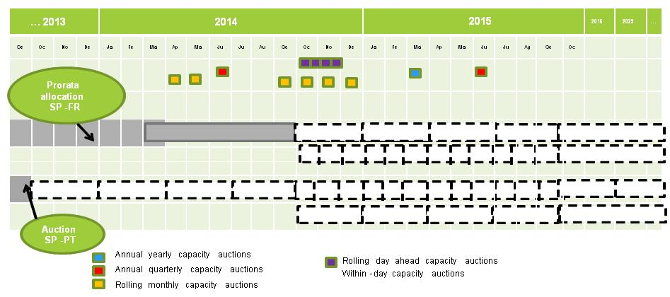
II. Capacity Allocation Mechanisms
II.1. CAM Roadmap for SGRI
1
Annual yearly auctions: 1st Monday of March / Y1: 1st Oct-31st Sept
Annual quarterly auctions: 1st Monday of June / Q1: 1st Oct-1st Jan.
Monthly capacity auctions: 3rd Monday of each month
Daily auctions: 16.30 CET D-1

Slide 12
II. Capacity Allocation Mechanisms
II.1. CAM Roadmap for SGRI
  Regulatory needs (I)
  Auction mechanism as a default CAM in the interconnections
  Moving towards bundled and virtual capacity
  Harmonizing the capacity products and timeframes
  New regulation need to be consistent with European NC:
    CMP NC
    Balancing NC
      Agreement on nomination and renomination schemes
    Interoperability and Data Exchange NC
      Harmonization of gas day / gas year- 2014
      Temperature to measure gas- 2014
      Units used to allocate capacity and sign contracts- 2014
    Tariffs NC:
      Reserve price
      Price to be paid by subscribers during all the contract life
2

Slide 13
II. Capacity Allocation Mechanisms
II.1. CAM Roadmap for SGRI
  Regulatory needs (II)
  To be discussed:
    Shipper license to participate in auctions process, allowing the same shipper to book unbundled capacity. Qualification steps.
    Price steps definition and allocation of revenues arising from the auction among TSOs
    Release of information to the market. Calendar
    Capacity contracts: obligation to subscribe the capacity allocated in the auction, timing, financial deposit...
    Responsibilities of TSOs (implementation) and NRAs (supervision)
    Secondary capacity market: bundled virtual capacity to remain as allocated in the auction
    Coexistence of old and new contracts
2

Slide 14
II. Capacity Allocation Mechanisms
II.1. CAM Roadmap for SGRI
  IT System
  To develop a single platform to allocate capacity: Best available technologies, functionalities, secure, smooth exchange of information
  Calendar to join European Capacity Platform by TSOs in the SGRI
  TSOs to develop its own IT system to integrate the information from the capacity auctions
  TSOs to collaborate bilaterally to develop IT systems for nomination and renomination of bundled capacity, CMP implementation, exchange information for balancing process.
3

Slide 15
II. Capacity Allocation Mechanisms
II.1. CAM Roadmap for SGRI
  Way forward
  Further discussion with TSOs - ASAP
  Public consultation of this document with Stakeholders- February 2013
  Final CAM Roadmap of the SGRI – March 2013
  Discussions and definition of the capacity products, available capacity and IT systems– April/May 2013
  Start of the implementation of IT systems –Summer 2013
  Start of proposing national regulation modification – Summer 2013.

Slide 16
II. Capacity Allocation Mechanisms
II.2. North West Capacity Allocation Platform
(to be presented by
Platform member)

Slide 17
II. Capacity Allocation Mechanisms
II.3. Improvements in the Spain-Portugal allocation of capacity
(to be presented by TSOs)

Slide 18
II. CAM
II.3. Improvements in the SP-PT CAM (I)
  Capacity Products to be offered for the gas year 1st Oct 2013 to 30th Sept 2014:
    Firm yearly products
    Firm quarterly products
    Interruptible products if less than 95% of firm capacity has been allocated at the previous firm products auctions.
  IT system to allocated capacity to shippers

Slide 19
II. CAM
II.3. Improvements in the SP-PT CAM (II)
  Annual Transmission Capacity Auction will take place in June 2013.
  National regulations to be aproved in advance in order stakeholders will be timely informed:
  Resolución CNE on methodology for the coordinated capacity allocation at the IP between Spain and Portugal.
  Mecanismo de atribuição de capacidade da RNTGN - ERSE
  Information Memorandum and Standard Contracts: to be elaborated by TSOs describing the procedures for the annual auction (following the Draft CAM NC): rules, price steps, reserve price, capacity offered, application form, contract information, calendar…. To be approved by NRAs.

Slide 20
II. Capacity Allocation Mechanisms
II.4. 2012 OSP ST Capacity between Spain and France
(to be presented by TSOs)

Slide 21
II. Capacity Allocation Mechanisms
II.5. Next steps and calendar
(for discussion)

Slide 22
III. Congestion Management Procedures
  III.1. CMP Roadmap (for information by TSOs)
  III.2. Next steps and calendar (for discussion)
Area of work | Responsible | Starting | Deadline
CMP harmonization proposal between SP-FR | NRAs-TSOs | Jan. 2011 | Dec. 2012
CMP harmonization proposal between SP-PT | NRAs-TSOs | Jan. 2012 | Jan. 2013

Slide 23
III. Congestion Management Procedures
III.1. Draft Roadmap for Congestion Management Procedures (CMP Roadmap)
(for information by TSOs)

Slide 24
III. Congestion Management Procedures
III.2. Next steps and calendar
(for discussion)

Slide 25
IV. Ten-Year Network Development Plan and Project of Common Interest (PCI)
IV.1. Update on PCI Identification (for information by regulators)
Area of work | Responsible | Starting | Deadline
Regular update and publication in CEER website of project status of OS 2013 and 2015 | TSOs - NRAs | Dec. (yearly) | Jun. (yearly)
Creation of a working group in the region in order to test the process of PCI identification | NRAs-TSOs | Apr. 2012 | Dec. 2012

Slide 26
IV. TYNDP and PCIs
IV.2 Update on PCIs identification (I)
North-South Gas Interconnections in Western Europe
  6th meeting held on 18 January: Previous meeting organized by EC with NRAs with the aim to know NRAs’ opinion. Summary on NRAS’ opinion on impact areas
  Main rule: a project must impact on at least two Member States to be eligible
  Clusters: projects considered in a cluster represent just one PCI.
  Presentation of analysis of qualitative and quantitative assessment carried out by consultants, as well as a preliminary PCIs list
  Main comments from attendants: impact areas, quantitative assessment (formulas application, parameters used, inputs, etc.). As a result, new calculations are being considered and a new list will be elaborated
  Participants were given time to send their opinion on impact areas and clusters
  Next meeting to be held in late February-early March

Slide 27
IV. TYNDP and PCIs
IV.2 Update on PCIs identification (II)
North-South interconnections in Western Europe

Slide 28
IV. TYNDP and PCIs
IV.2 Update on PCIs identification (III)
North-South interconnections in Western Europe

Slide 29
IV. TYNDP and PCIs
IV.2 Update on PCIs identification (IV)
North-South interconnections in Western Europe

Slide 30
V. Developing hub-to-hub trading in the South region
V. 1. Proposal of models for the integration of the Spanish and Portuguese gas markets in an Iberian natural gas hub
Area of work | Responsible | Starting | Deadline
Hub development | NRAs-TSOs-stakeholders | Jan.2013 | Dec. 2013
Hub-to-hub gas trading in the region | NRAs-TSOs-stakeholders | Jan.2014 | Dec.2014

Slide 31
V. Developing hub-to-hub trading in the South region
V. 1. Proposal of models for the integration of the
Spanish and Portuguese gas markets in an Iberian natural gas hub
(for information by NRAs)

Slide 32
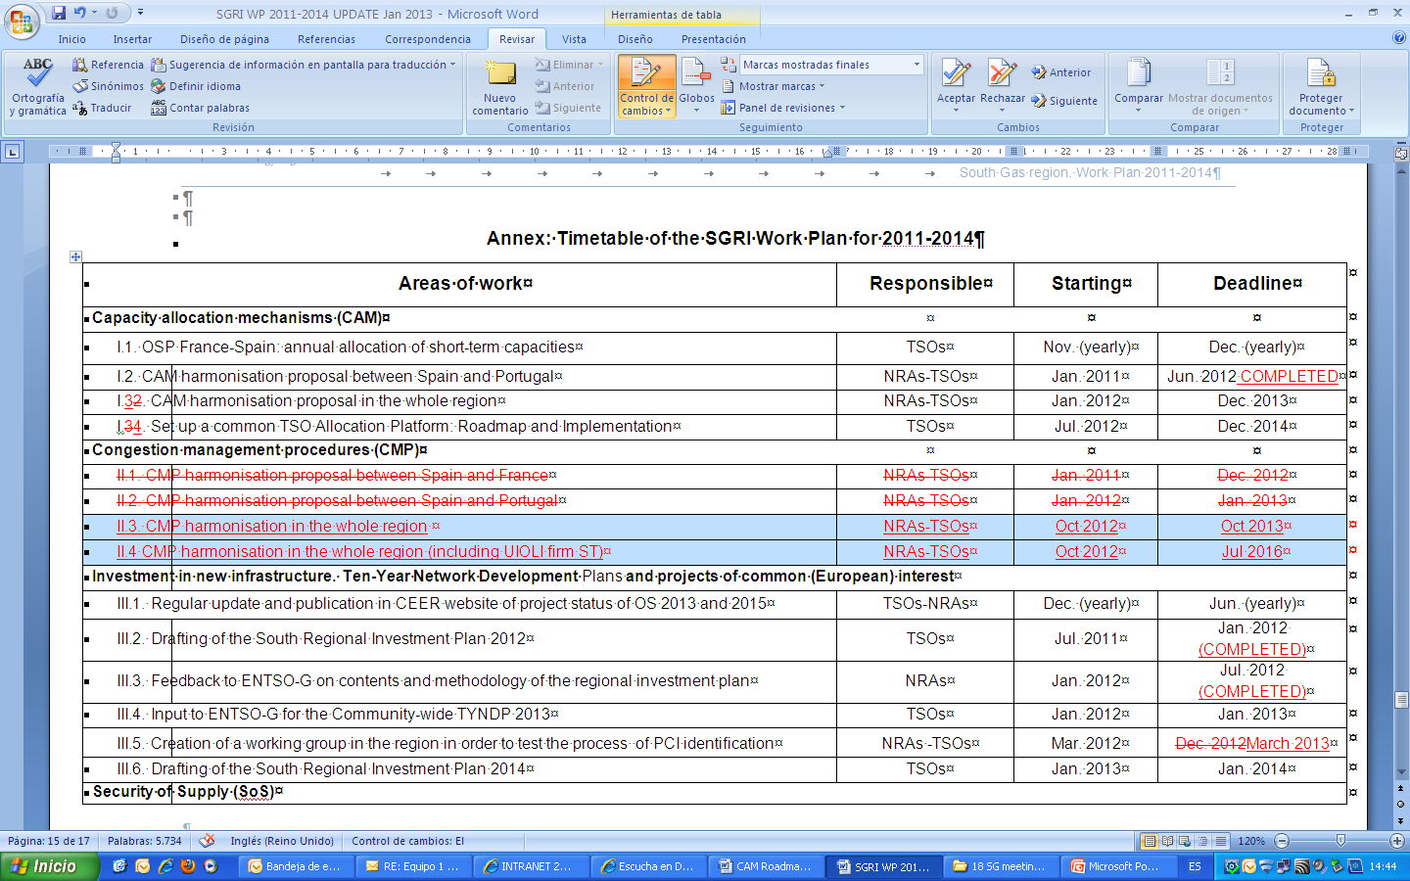
VI. Review of actions in the WP 2011-2014 (I)
Areas of work | Responsible | Starting | Deadline

Slide 33
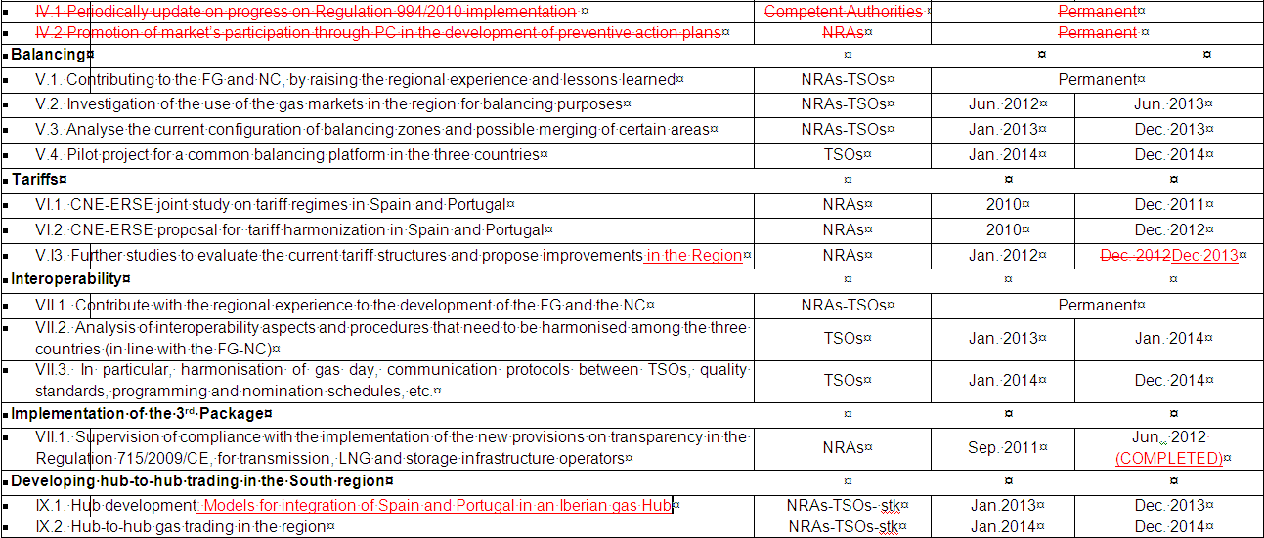
VI. Review of actions in the WP 2011-2014 (II)
Areas of work | Responsible | Starting | Deadline

Slide 34
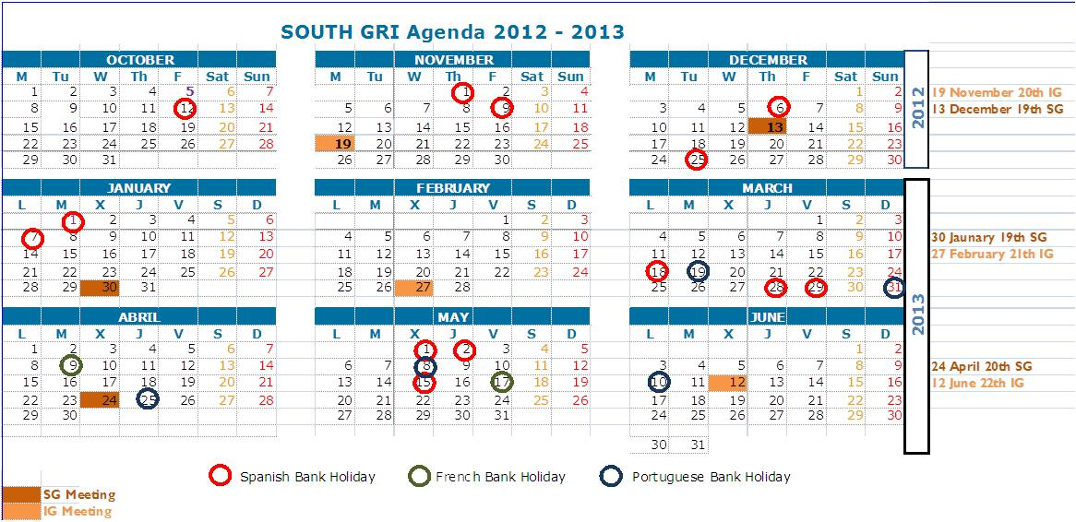
Calendar 1st semester 2013 - SGRI
Next meetings:
27 February: 21th IG
24 April: 20th SG
12 June: 22th IG

